Slide 1
Traditional Risk Management Plans
Risk Management
By
Robert B. Kauffman
Focus
(click to advance)

Slide 2
Traditional Risk Management Plans
It’s the kick off!
by
Robert B. Kauffman, Ph.D.
This section focuses on developing a risk management plan to reduce the likelihood of an accident or lawsuit from occurring.
By managing the risks, you reduce the risks. Avoid the accident, avoid the law suit. Accidents don’t happen by chance
(click to advance)

Slide 3
Risk Management:
It is presented on the right as part of the integrated risk management model.
Historically, linked closely with legal liability.
Generally, it is an organizational or agency approach toward managing the risks facing the organization.
Also, it is a generic term.
This section focuses on developing a risk management plan to reduce the likelihood of an accident or lawsuit from occurring.
This power point is taken from Chapter 8 in the forthcoming book: Kauffman and Moiseichick, M., (2013), Integrated Risk Management in Recreation and Parks. Champaign, Illinois: Human Kinetics.
(click to advance)

Slide 4
Risk Management:
It is presented on the right as part of the integrated risk management model.
Historically, linked closely with legal liability.
Generally, it is an organizational or agency approach toward managing the risks facing the organization.
Also, it is a generic term.
This section focuses on developing a risk management plan to reduce the likelihood of an accident or lawsuit from occurring.
This power point is taken from Chapter 8 in the forthcoming book: Kauffman and Moiseichick, M., (2013), Integrated Risk Management in Recreation and Parks. Champaign, Illinois: Human Kinetics.
(click to advance)

Slide 5
Parameters:
The following are the parameters generally associate with risk management plans and this unit.
They tend to be implemented at the organizational or firm level.
“What can the organization do to reduce injury, damage, or loss.”
Think of it as a three fold process:
1) Identify potential risks
2) Identify the risks (probability, impact, and severity).
3) Develop risk strategies (i.e. transfer, reduce, avoid, retain)
Risk mgmt plan dovetails with the accident process and negligence.
(see Table 8.5 later)
The first step is to identify the risks. …. (See the next slide.)
Source: Kauffman and Moiseichick, M., (2013), Integrated Risk Management in Recreation and Parks. Champaign, Illinois: Human Kinetics.
(click to advance)

Slide 6
Risk Identification:
The 1st step in developing a risk management plan is to identify and assess potential risks.
Types:
Tort
Contract
Property
Business
Human rights
Parties:
Agency
Board
Employees
Volunteers
Hazards:
Environmental
Infrastructure
Programmatic
Emergency
Transportation
(hazards expanded three slides from here)
We indicated that we would identify all risks, didn’t we? Try not to get hung up on all the lists.
Yes, try not to get hung up on the list. It is always a resource for later use.
van der Smissen, B., Moiseichick, M., and Hartenburg, V. (ed), (2005), Management of Park and Recreation Agencies. Ashburn, Virginia: National Recreation and Park Association. Ch.19.
(click to advance)

Slide 7
Types of Losses:
Tort/negligence:
Contractual losses:
Breach of contracts within your agency or with the subcontractors
Property losses:
Natural causes (e.g. snow, hail, rain, flood, lightning, etc.)
Human causes (e.g. vandalism, theft, riot, acts of terror, etc.)
Financial business losses:
Embezzlement and theft
Employee accidents and injuries – workers’ compensation
Human rights losses:
Sexual harassment
Discrimination – age, gender, disability, religion, ethnicity, etc.
Discrimination in use of facilities.
Physical and sexual abuse of children, disabled and elderly
All this is another way to list the possible losses.
(click to advance)

Slide 8
Parties:
Respondeat superior:
Board members: Generally, individual board members are not liable for collective actions.
They are responsible for collective acts outside their scope of authority (e.g. ACA)
Intentional torts (e.g. assault and battery, slander, libel)
Employee: Employees, supervisors, administrators are generally responsible for their own negligence. They are generally not liable for their subordinates negligence as long as they didn’t contribute to the act.
Volunteers: Volunteers are responsible for their own conduct unless they qualify under the Volunteer Protection Act or a state statute, and unless negligence is imputed to the agency under respondeat superior.
Respondeat superior… Ugh! … This slides ties the discussion back to legal liability.
.
van der Smissen, B., Moiseichick, M., and Hartenburg, V. (ed), (2005), Management of Park and Recreation Agencies. Ashburn, Virginia: National Recreation and Park Association. Ch.19.
(click to advance)

Slide 9
Risks/Hazards:
Risk/Hazard Typology:
Environmental hazards: nature or natural conditions
Slippery surfaces
Falling objects
Steep slopes or vertical drops
Dangerous plants or animals
Weather conditions
Water hazards
Lighting and visibility
Infrastructure hazards: includes all structures – facilities, buildings, roads and trails.
Slippery and uneven surfaces
Design/layout defects
Fences and other barriers (continued on next slide)
Ah… another list. These hazards can easily lead to accidents.
van der Smissen, B., Moiseichick, M., and Hartenburg, V. (ed), (2005), Management of Park and Recreation Agencies. Ashburn, Virginia: National Recreation and Park Association. Ch.19.
(click to advance)

Slide 10
Risk Identification (Hazards):
Program hazards:
Supervision
Following safety rules
Background checks
Participant fitness
Use of appropriate safety devices and equipment
Age appropriate activities
Experience appropriate activities
Failure to warn
Emergency care hazards: recreation and parks organizations have a duty to provide emergency first aid to visitors and program participants.
Crisis Management: staff need to be trained in how to handle a crisis. These are more than normal emergencies.
Weather - Tornados, hurricanes, blizzards
Forest fires, or building fires
Terrorist attacks
Chemical spill - chlorine pool
Transportation hazards: Only applicable if transporting passengers.
Appropriate type of vehicles
Properly maintained
Driver – license, training on type of vehicle, record
Let’s breeze through this list.
van der Smissen, B., Moiseichick, M., and Hartenburg, V. (ed), (2005), Management of Park and Recreation Agencies. Ashburn, Virginia: National Recreation and Park Association. Ch.19.
(click to advance)

Slide 11
Risk Identification (Hazards):
The 2nd step in developing a risk management plan is to identify the frequency (probability), impact, and severity of the risks using high, medium, or low scale.
Figure 8.5 becomes the basic working table. (next slide)
Winding River Canoe Rental example of assessment (2nd slide)
Risk (Col.#1)
Consequence (Col.#2)
Probability (Col.#3)
Severity (Col.#5)
Impact (Col.#7)
Finally, Step 2…. It is all about frequency, impact, and severity…. Don’t dwell too long here. More follows….
Source: Kauffman and Moiseichick, M., (2013), Integrated Risk Management in Recreation and Parks. Champaign, Illinois: Human Kinetics.
(click to advance)

Slide 12
Risk Identification (Hazards):
The 2nd step in developing a risk management plan is to identify the frequency and severity of the risks.
We will use Figure 8.5 as the basic working table for assessing the risks and their impacts.
Definitions and analysis on following slides.
+
=
Source: Kauffman and Moiseichick, M., (2013), Integrated Risk Management in Recreation and Parks. Champaign, Illinois: Human Kinetics.
(click to advance)

Slide 13
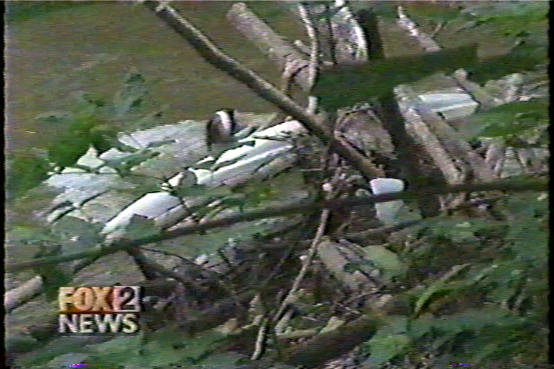
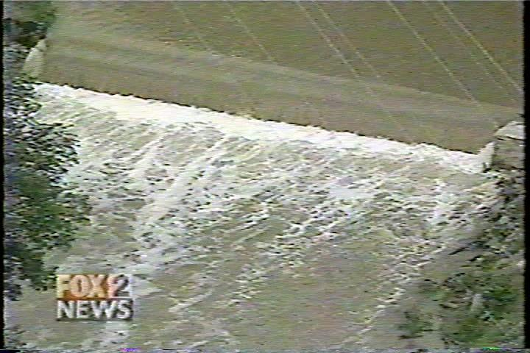
Winding River Canoe Rental Example:
Definitions of probability, impact, and severity on following slides.
Source: Kauffman and Moiseichick, M., (2013), Integrated Risk Management in Recreation and Parks. Champaign, Illinois: Human Kinetics.
(click to advance)

Slide 14
Probability determination:
Determine the probability, impact, and severity for each event (Figure 8.6, 8.7, and 8.8) [Col.#3].
Rate each of the risks determined in terms of the probability of its occurrence (this slide).
Source: Kauffman and Moiseichick, M., (2013), Integrated Risk Management in Recreation and Parks. Champaign, Illinois: Human Kinetics.
(click to advance)

Slide 15
Impact determination:
Essentially, what is the impact of the incident from catastrophic to insignificant [Col.#5].
Source: Kauffman and Moiseichick, M., (2013), Integrated Risk Management in Recreation and Parks. Champaign, Illinois: Human Kinetics.
(click to advance)

Slide 16
Severity determination:
Using the matrix in Figure 8.8, determines the severity for a risk by cross-referencing the probability with the impact for an event occurring [Col.#7].
Severity is nothing more than the arbitrary cross-tabulation as defined by this table.
(The permutations for all impacts are shown in the next slide (Figure 8.9))
Source: Kauffman and Moiseichick, M., (2013), Integrated Risk Management in Recreation and Parks. Champaign, Illinois: Human Kinetics.
(click to advance)

Slide 17
Severity permutations:
Think of this table working backwards from Col.#7. [Restates previous table]
Source: Kauffman and Moiseichick, M., (2013), Integrated Risk Management in Recreation and Parks. Champaign, Illinois: Human Kinetics.
(click to advance)

Slide 18
Develop Strategies:
The 3rd step in developing a risk management plan is to determine strategies on how to deal with the risks.
Risk financing techniques - the emphasis is on how to finance the loss or transfer it to another party.
Transfer
Retain
Risk control techniques – the emphasis is on minimizing the risk of loss.
Avoidance
Reduction
If you are in the business of providing an activity or program, risk reduction is the method for you.
Source: Kauffman and Moiseichick, M., (2013), Integrated Risk Management in Recreation and Parks. Champaign, Illinois: Human Kinetics.
(click to advance)

Slide 19
Develop Strategies:
The 3rd step in developing a risk management plan is to determine strategies on how to deal with the risks.
Risk financing techniques - the emphasis is on how to finance the loss or transfer it to another party.
Transfer
Retain
Risk control techniques – the emphasis is on minimizing the risk of loss.
Avoidance
Reduction
Peterson, J., (1987), Risk Management for Park, Recreation, and Leisure Services. Champaign, Illinois: Management Learning Laboratories.
(click to advance)

Slide 20
Underlying Factors:
The underlying factors in the Domino and other models can be used in risk reduction to analyze activities and programs and to create safer programs.
Addressing these factors can reduce the frequency, impact, and severity.
Human Factors:
Physical or physiological capabilities or stress
Mental or physiological capabilities or stress
Knowledge
Skill
Motivation and group dynamics
Preplanning
Environmental Factors:
Weather and changes in weather
Terrain and changes in terrain conditions
Animals and plants
Equipment Factors:
Inadequate or inappropriate clothing
Inadequate or inappropriate equipment
Inadequate maintenance or wear and tear
You can use the underlying factors independently of the domino mode….
Let’s watch the dominos fall.
(click to advance)

Slide 21
Dovetailing with Accident Process (e.g. Curtis Model)
Think of increased probability increasing the size to the golf balls.
(Curtis, R., (2005) The Backpacker’s Field Manual. New York: Three Rivers Press.)
(click to advance)

Slide 22
Risk Transfer:
Give the ball (risk) to someone else and let them hold onto the risk.
Three General Approaches:
Insurance approach – attempts to transfer the loss to a third party such as an insurance company.
Subcontracting – attempts to transfer the risk of loss to the subcontractor performing the service or activity.
Indemnification and hold-harmless clauses – attempts to transfer the risk to the participant
Approaches are not mutually exclusive of each other.
I like this strategy… It lets someone else hold the ball and get tackled.
Insurance
(third party)
Waiver
(participant)
Subcontractor
(independent contractors)
Source: Kauffman and Moiseichick, M., (2013), Integrated Risk Management in Recreation and Parks. Champaign, Illinois: Human Kinetics.
(click to advance)

Slide 23
Risk Transfer:
Give the ball (risk) to someone else and let them hold onto the risk.
Three General Approaches:
Insurance approach – attempts to transfer the loss to a third party such as an insurance company.
Subcontracting – attempts to transfer the risk of loss to the subcontractor performing the service or activity.
Indemnification and hold-harmless clauses – attempts to transfer the risk to the participant
Approaches are not mutually exclusive of each other.
Unfortunately, this strategy doesn’t reduce the risks, and it may give me a false sense of security.
Insurance
(third party)
Waiver
(participant)
Subcontractor
(independent contractors)
Source: Kauffman and Moiseichick, M., (2013), Integrated Risk Management in Recreation and Parks. Champaign, Illinois: Human Kinetics.
(click to advance)

Slide 24
Insurance:
Insurance – You pay a third party to assume the risk for the injury, damage, or loss which you created or which occurred to you.
It may create a false sense of security. It removes the financial aspects, but it doesn’t reduce anything else…
Going out of business
Post traumatic stress syndrome (see EAP pwrpt)
Incidental and opportunity costs
People will leave the profession, or your organization.
Bad publicity for your organization.
Be smart, behave as if you were self-insured.
Ten yards and a cloud of dust… I will hand the ball off to the insurance company and let them get tackled.
(click to advance)

Slide 25
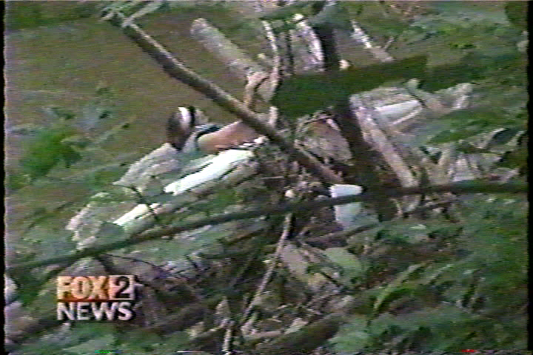
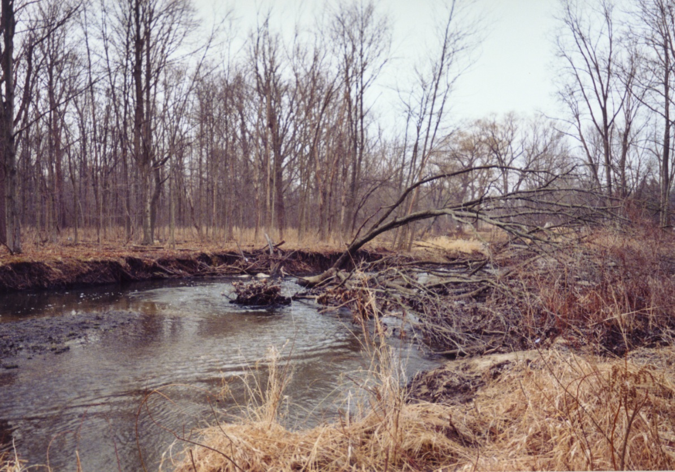
Subcontracting:
Example #1: Winding Rivers
Clinton River, Michigan
Shelby County Recreation and Parks Department subcontracted to Winding Rivers to operate a canoe and kayak rental service on the river.
Melanie Carlson died on this strainer.
Janice Cody, owner and operator of Winding Rivers was totally incompetent at best.
The Court excused Shelby County R&P from the lawsuit.
They successfully transferred their risk to Winding River and Janice Cody.
Same strainer, same day, different person, 750 cfs
Benign current, lots of strainers, lazy river, 250 cfs
(click to advance)

Slide 26
Waivers:
The Tug-of-War
Waivers are increasingly considered valid by the courts.
They are considered a contract between two consenting parties.
The difference rests between ordinary and gross negligence.
Ordinary negligence can be waived.
Gross negligence isn’t.
It is like a tug-of-war between the participant and the company regarding who will assume the risk…
Which side wins?
You mean that if I sign this waiver, I agree not to sue you even if you screw up.
Sign this waiver or you can’t participate. Oh, by the way you agree to assume all the risks, even if I screw up.
(Click for bubble)
The Participant
The Company
Peterson, J., (1987), Risk Management for Park, Recreation, and Leisure Services. Champaign, Illinois: Management Learning Laboratories.
(click to advance)

Slide 27
Retain Risks:
I assume the loss.
Retain Risks - is where the organization keeps the risk itself and accepts the responsibilities (legal and financial) for any consequences which occur.
Self-insured:
Government – taxes
Sinking fund
Go out of business:
Partially Retained – the use of higher insurance deductibles.
Oh dear!!! They are all after me!
On this play, I think that I am out of business…. They must all be lawyers!
Source: Kauffman and Moiseichick, M., (2013), Integrated Risk Management in Recreation and Parks. Champaign, Illinois: Human Kinetics.
(click to advance)

Slide 28
Risk Avoidance:
Risk Avoidance – eliminates the risk and hence, any problems associated with the risk.
If you don’t do the activity there can’t be any injury, damage, or loss.
You consider getting out of the business.
You consider eliminating the program.
Also, it can be the temporary cessation of the activity (e.g. high water)
Expletive deleted!!! I guess that we need to be more proactive in our risk management plan.
Drop back ten… punt the ball (risk), and hope the other team fumbles.
Source: Kauffman and Moiseichick, M., (2013), Integrated Risk Management in Recreation and Parks. Champaign, Illinois: Human Kinetics.
(click to advance)

Slide 29
Risk Reduction:
Risk Reduction – is an approach where you attempt to reduce the probability of an incident from occurring or the severity of an incident if it does occur.
Inspect
Warn
Remove
Repair
Remember, if there is no injury damage or loss and there is no accident, lawsuit or need for an emergency action plan.
The following example uses a playground evaluation to illustrate the four risk management strategies:
(examples of each of four methods on following slides)
Oh, dear. The trainer inspected my leg, warned me, and recommended this cold bath to prevent (repair) any damage.
If all this doesn’t work, they will remove me from the roster. That is not good.
Source: Kauffman and Moiseichick, M., (2013), Integrated Risk Management in Recreation and Parks. Champaign, Illinois: Human Kinetics.
(click to advance)

Slide 30
Inspect:
Inspection can take several forms (no pun intended):
The check off list (on the right) is an important component.
Check off list is based on the Dirty Dozen brochure:
Surfacing
Fall zones
Protrusions
Supervision
Equipment not recommended for public playgrounds
etc.
Check off lists can include medical forms, incident reports, etc.
The Dirty Dozen, Are They Hiding on Your Playground. (1994), Ashburn, Virginia: National Recreation and Parks Association.
(click to advance)

Slide 31
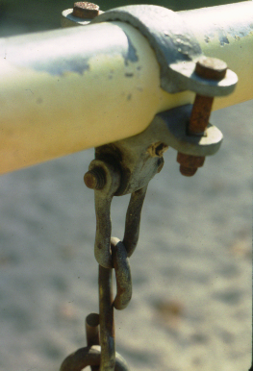
Repair:
A good inspection program leads to the repair, replacement or removal of equipment.
Example #1: Frozen bearing
Without proper lubrication, the bearing freezes
This makes the “S” hook the bearing (note: excessive wear) (click to advance)
Example #2: Surfacing
The swing has inadequate mulch (12” min)
Note hollowed out area
Also, insufficient fall zone
If a child is hurt from the frozen bearing or inadequate surfacing, injury damage or loss occurs…
Write the check.
Playground Safety is not an accident by Kutska, Hoffman and Malkuska, National Recreation and Parks Association, 1998.
(click to advance)

Slide 32
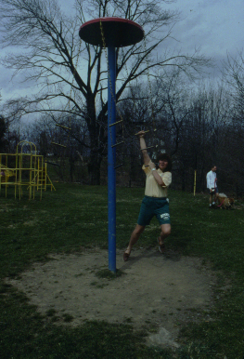
Remove:
Normally, removal of equipment is the last alternative.
Standards change necessitating removal and replacement of equipment.
Example #1: Middle swing
The middle swing was removed bringing this swing into conformity with the standards. (note: two clamps for swing similar to upper picture) (click to advance)
Example #2: Inappropriate equipment
The Giant Stride on the right resulted in numerous injuries and is considered inappropriate on today’s playgrounds.
It should be removed.
Again, if a child is hurt on the Giant Stride…. Write the check.
Kauffman, R., (2004), Playground Safety, Power point Frostburg, MD: FSU
(click to advance)

Slide 33
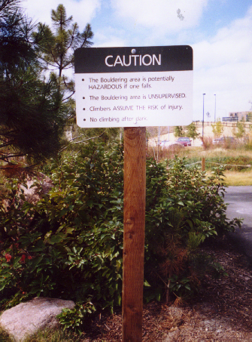
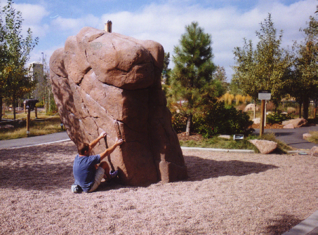
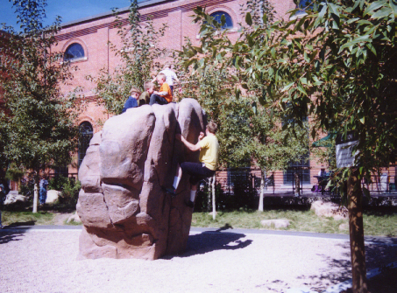
Warning:
In today’s society don’t assume people have the knowledge, skills, abilities, or experiences to safely perform the activity.
Four examples:
#1: Bouldering rock – REI.
#2: Jet plane – Constitution Park
#3: Bike trail - REI.
#4: Meramec River
Example #1: Bouldering – Denver REI
It is potentially hazardous (why do you have it… state it positively)
Supervision – unintentional use
Issue: If you erect a warning sign do you acknowledge the hazard and the fact that it should have been removed? (click for kids)
Kauffman, R., (2004), Playground Safety, Power point Frostburg, MD: Frostburg State University.
(click to advance)

Slide 34
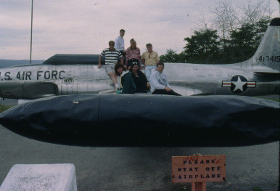
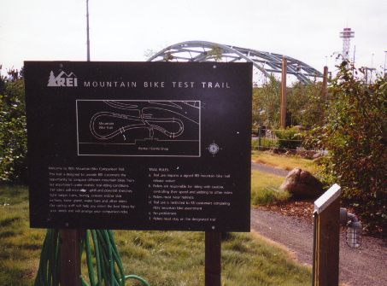
Warning:
Example #2: Jet Airplane
Constitution Park
“Please stay off airplane” – Why is the airplane in the park/playground, if it is a hazard? (note: playground performance standards. If people play on it, it needs to meet playground standards.) (click to advance)
Example #3: REI Bike Trail
Denver, Colorado
Trail entrance sign (Note: loop design)
Signs are informative or “interpretive” and let you know what is coming up on the trail. But they also warn (next slide)
They sidestep the hazard issue.
Kauffman, R., (2004), Playground Safety, Power point Frostburg, MD: FSU.
(click to advance)

Slide 35
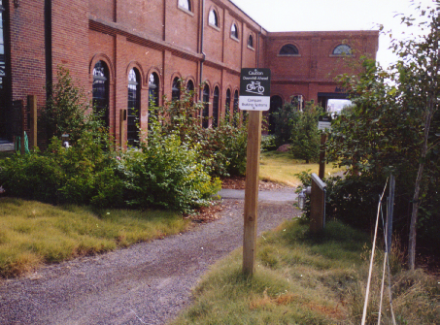
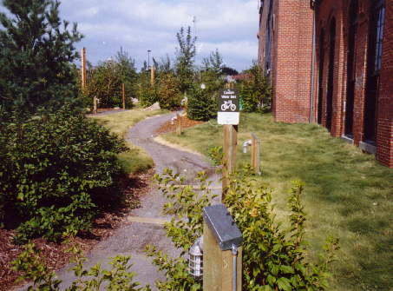
Warning:
Sign warns bikers to test their brakes on the decline
First sign reads: “Caution downhill ahead”
Second sign reads: “Compare braking systems.”
From previous slide:
Concept of “foreseeable”
Signs are informative or “interpretive” and let you know what is coming up on the trail. They also warn.
Do they sidestep the hazard issue?... Possibly?
Bottom photo warns of upcoming “waterbar.”
Consider a person injuring themselves because of a waterbar. The sign warns by informing.
Kauffman, R., (2004), REI Bike Trail, Power point Frostburg, MD: FSU.
(click to advance)

Slide 36
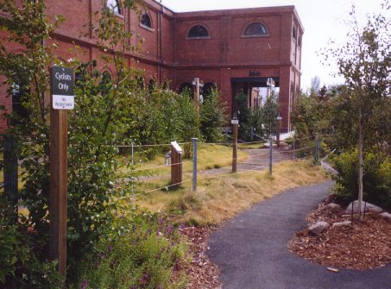
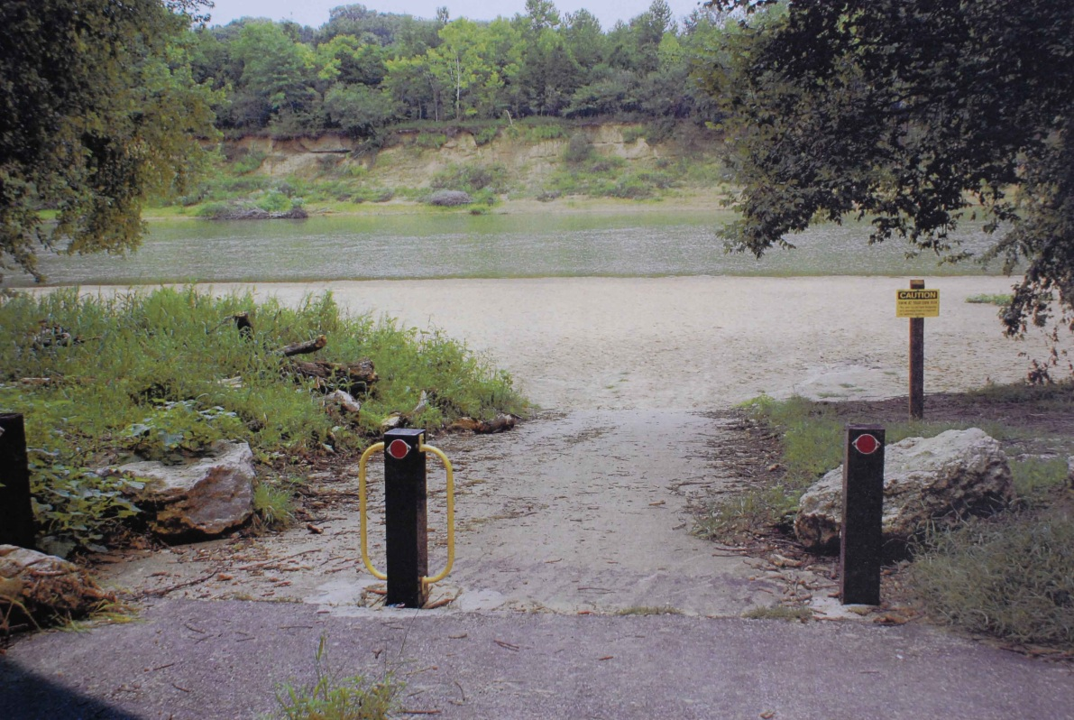
Warning:
Top photo - Sign reads “Cyclists Only” and “No Pedestrians”
Sign at entrance limits use.
Note fence keeps people on the trail.
Note lights for night use. (click to advance)
Example #4: Meramec River
Outside St. Louis, Missouri
Caution sign was erected after multiple drowning fatalities.
It is the typical “Caution – Swim at you own risk”
Apply interpretive signage
Again, there is the “hazard” issue. (Continued on next slide)
Kauffman, R., (2004), REI Bike Trail, Power point Frostburg, MD: FSU.
(click to advance)

Slide 37
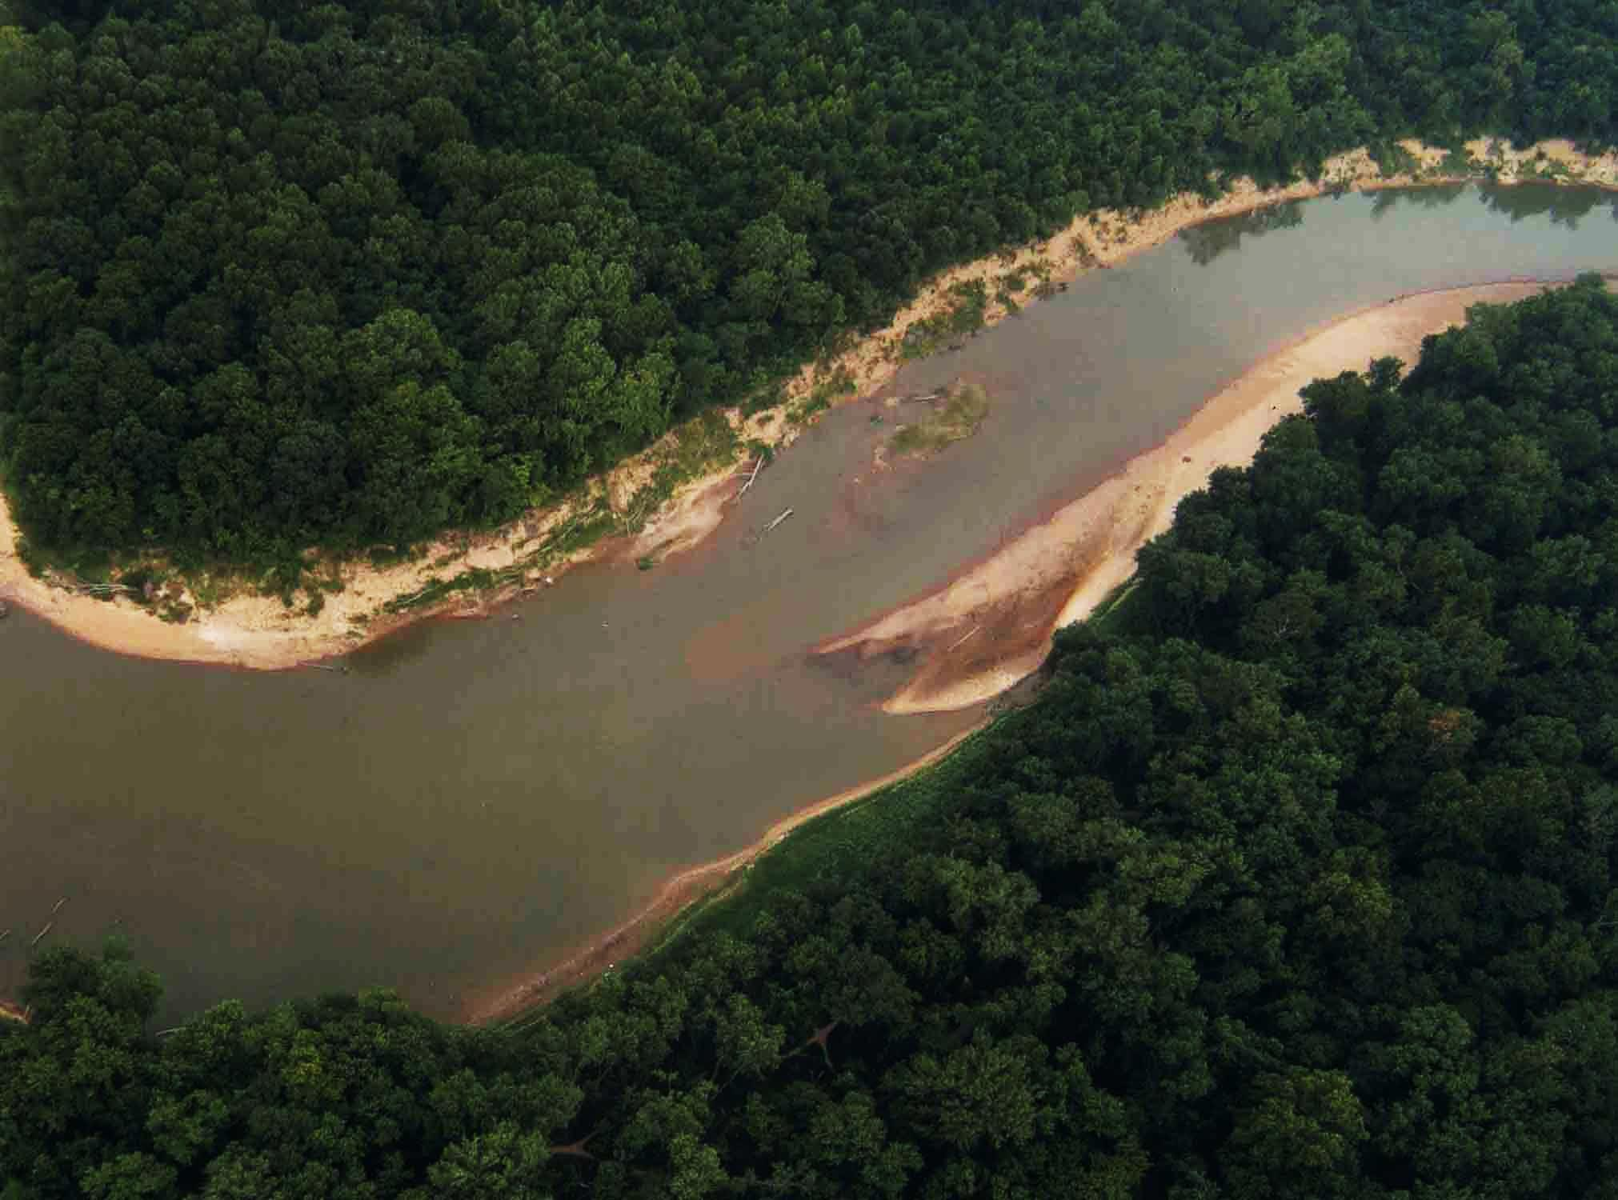
Warning:
Example #4: Meramec River (continued from previous slide)
Caution sign was erected after multiple drowning fatalities.
It is the typical “Caution – Swim at you own risk”
Again, there is the “hazard” issue. Are they acknowledging the drop off?
The urban non-swimmers who use the park have no concept of the dangers.
Does the park have a duty to educate, interpret, or warn users of the hazards and/or drop off?
Do they need to require life jackets?
4
2
5
1
3
Kauffman, R., (2007), Merrimec River, Power point Frostburg, MD: FSU
(click to advance)

Slide 38
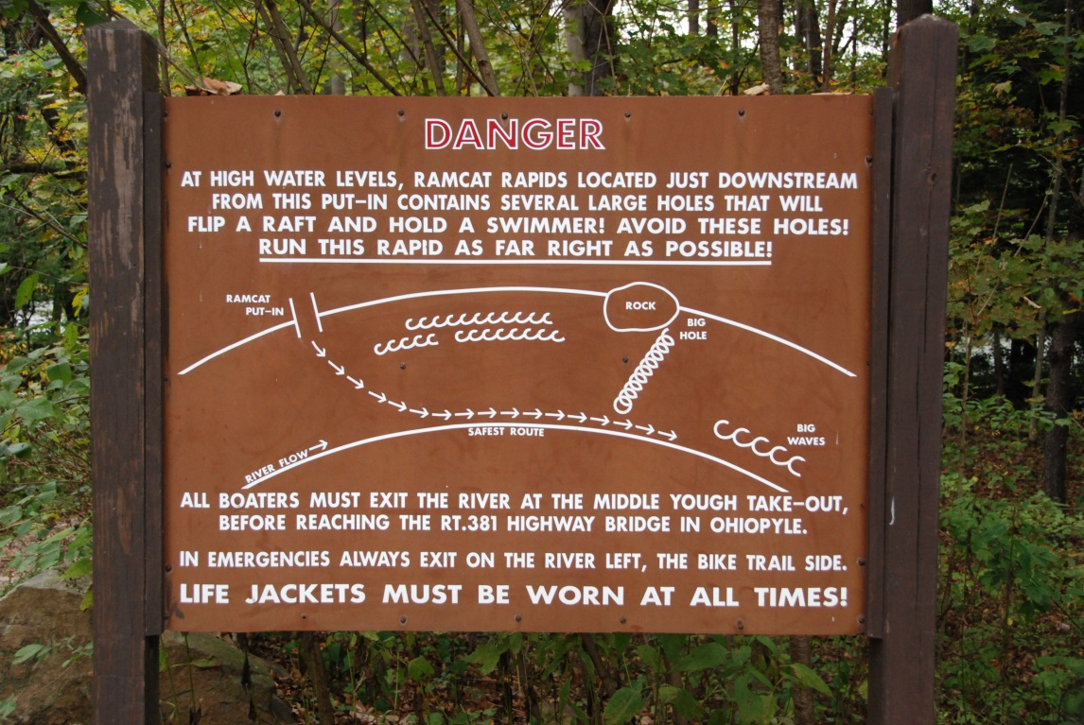
Interpretive Signage - Winding River:
Example #5: Yates Dam (Put-in)
Interpretive sign at put-in indicating river hazards (strainers, dams, etc)
Include Yates Dam portage as part of the talk-up at the put-in.
(click for dam site on next slide)
4
2
1
3
Example of Interpretive (Warning) Signage – Middle Yough
Yates Dam - high water with hydraulic
(click to advance)

Slide 39
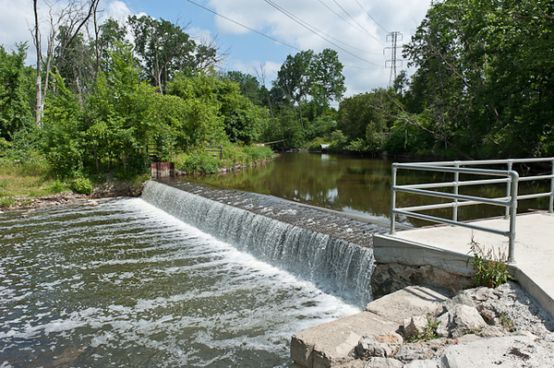
Interpretive Signage - Winding River:
Example #5: Yates Dam (at the Dam)
Portage trail
Sign on river indicating portage trail
(click for portage)
4
2
5
1
3
Yates Dam - low water
Yates Dam - high water with hydraulic
(click to advance)

Slide 40
Effective severity:
Figure 8.10 is an extension of Figure 8.9 and reflects the severity after mitigation has occurred.
Source: Kauffman and Moiseichick, M., (2013), Integrated Risk Management in Recreation and Parks. Champaign, Illinois: Human Kinetics.
(click to advance)

Slide 41
Winding River Canoe Rental Example:
e.g. remove strainers, create portage trail, close operations at high water, etc.
+
=
Source: Kauffman and Moiseichick, M., (2013), Integrated Risk Management in Recreation and Parks. Champaign, Illinois: Human Kinetics.
(click to advance)

Slide 42
Winding River Canoe Rental Example:
Mitigation changes probability and contingencies changes impact.
(discussion on next slide)
+
=
Source: Kauffman and Moiseichick, M., (2013), Integrated Risk Management in Recreation and Parks. Champaign, Illinois: Human Kinetics.
(click to advance)

Slide 43
Winding River Canoe Rental Example:
Strainers - Remove harmful strainers, use gauge and lower high water cut off, interpretive signs on danger of strainers and how to swim. ➔ Lowers both probability and impact. ➔ [M]
Yates Dam - Install portage trail, place signage at entrance of trail, interpretive signage and warnings at put-in. ➔ Lowers both probability and impact. ➔ [L]
Source: Kauffman and Moiseichick, M., (2013), Integrated Risk Management in Recreation and Parks. Champaign, Illinois: Human Kinetics.
(click to advance)

Slide 44
Winding River Example:
Figure 8.14: Conversion Table.
Risk Level | Probability Equivalence
H | 0.8
M | 0.5
L | 0.2
NA | 0.0
TBD | 0.9
Source: Kene, K., et al (2010) How to Develop a Risk Management Plan. WikiHow.
Conversion table – In order to determine the percent change in safety, H/M/L need to be converted to probabilities. Table 8.14 does this.
Figure 8.17: Risk Management Working Table - Winding River Canoe Rentals
Risks (1) | Consequences (2) | Probability (3) | Effective Probability (4) | Impact (5) | Effective Impact (6) | Severity (7) | Effective Severity (8)
Strainers | Potential fatalities at higher water | M | M | H | M | H | M
Yates Dam | Potential fatalities at high water in hydraulic | M | L | M | M | M | L
Gauge | Relates to water level and administrative use practices | M | L | L | L | L | L
Source: Kene, K., et al (2010) How to Develop a Risk Management Plan. WikiHow.
Source: Kauffman and Moiseichick, M., (2013), Integrated Risk Management in Recreation and Parks. Champaign, Illinois: Human Kinetics.
(click to advance)

Slide 45
Winding River Example:
Figure 8.14: Conversion Table.
Risk Level | Probability Equivalence
H | 0.8
M | 0.5
L | 0.2
NA | 0.0
TBD | 0.9
Source: Kene, K., et al (2010) How to Develop a Risk Management Plan. WikiHow.
Conversion table – In order to determine the percent change in safety, H/M/L need to be converted to probabilities. Table 8.14 does this.
(Calculations on next slide)
Figure 8.17: Risk Management Working Table - Winding River Canoe Rentals
Risks (1) | Consequences (2) | Probability (3) | Effective Probability (4) | Impact (5) | Effective Impact (6) | Severity (7) | Effective Severity (8)
Strainers | Potential fatalities at higher water | M | M | H | M | H ➜ 0.8 | M ➜ 0.5
Yates Dam | Potential fatalities at high water in hydraulic | M | L | M | M | M ➜ 0.5 | L ➜ 0.2
Gauge | Relates to water level and administrative use practices | M | L | L | L | L ➜ 0.2 | L ➜ 0.2
Source: Kene, K., et al (2010) How to Develop a Risk Management Plan. WikiHow.
Source: Kauffman and Moiseichick, M., (2013), Integrated Risk Management in Recreation and Parks. Champaign, Illinois: Human Kinetics.
(click to advance)

Slide 46
Winding River Example:
We can actually measure the increase in safety resulting from the safety measures that we have taken…. WOW!
The safety measures taken result in 43% reduction in severity.
You can do this for programs and activities just as easily as for facilities and areas.
Figure 8.15: Calculating Effectiveness of Risk Management Measures.
Severity ¹ (7) | Severity Converted to Probability Using Figure 8.14 | Effective Severity ¹ (8) | Effective Severity Converted to Probability Using Figure 8.14
H | 0.8 | M | 0.5
H | 0.8 | M | 0.5
M | 0.5 | L | 0.2
 | 2.1 |  | 1.2
Effective Severity - Severity = Difference / Severity x 100 = % reduction 2.1 - 1.2 = .9 / 3.9 = .23 x 100 = 23% reduction in severity of risks.
¹ from Figure 8.17. Adapted from: Kene, K., et al (2010). How to Develop a Risk Management Plan. WikiHow.
2.1 = .43 x 100 = 43%
Source: Kauffman and Moiseichick, M., (2013), Integrated Risk Management in Recreation and Parks. Champaign, Illinois: Human Kinetics.
(click to advance)

Slide 47
Risk Management Plan:
The listing on the following pages is an outline for a risk management plan.
For the plan to be successful, it is important that these components be integrated into the normal operations and fabric of the organization.
Add/delete sections as needed
Monitor performance and revise the plan periodically. Establish safety rules, procedures and regulations.
Develop an incident (accident) reporting system to provide feedback.
Perform safety inspections.
We can actually measure the increase in safety resulting from the safety measures that we have taken…. WOW!
van der Smissen, B., Moiseichick, M., and Hartenburg, V. (ed), (2005), Management of Park and Recreation Agencies. Ashburn, Virginia: National Recreation and Park Association. Ch.19.
(click to advance)

Slide 48
Risk Management Plan:
Generic Contents of a Risk Mgmt Plan
(Section titles)
Organizational structure
Goals and objectives
Conduct of programs and services
Human resources policies
Supervisory functions
Emergency plans and procedures (EAPs)
Emergency plans and procedures
Protection against criminal acts and security
Transportation and vehicles
Equipment
Environmental conditions
Developed areas and facilities
(More on next slide)
Risk management is much broader than just accidents….. Save the list for future reference.
van der Smissen, B., Moiseichick, M., and Hartenburg, V. (ed), (2005), Management of Park and Recreation Agencies. Ashburn, Virginia: National Recreation and Park Association. Ch.19.
(click to advance)

Slide 49
Generic Contents of a Risk Mgmt Plan:
Organizational structure
The team – who’s in charge; roles
Goals and objectives
Licenses, leases, insurance, permits, rentals
Conduct of programs and services
Program and facility standards (e.g. playground, aquatics, fitness, etc.)
Type of participants (ADA)
Special events
Warnings (importance and roles)
Medical/health exams/forms
Joint sponsorships
Use of waivers
Participant forms (e.g. registration, entry, agreements, photo, etc.)
Human resources policies
Occupational safety standards
Hiring and discharge
Sexual harassment
Violence in the workplace
Sexual and physical abuse of children, elderly, disabled
Supervisory functions
Management of behavior (e.g. discipline, crowd control, violence, use of drugs, intoxication, etc.)
Rules and regulations
Emergency plans and procedures (EAPs)
Personal injury of partici- pants, spectators, visitors
First aid
Hierarchy of service
(More on next slide)
Risk management is much broader than just accidents….. Save this list for future reference.
This list is for illustrative purposes and for future reference.
van der Smissen, B., Moiseichick, M., and Hartenburg, V. (ed), (2005), Management of Park and Recreation Agencies. Ashburn, Virginia: National Recreation and Park Association. Ch.19.
(click to advance)

Slide 50
Generic Contents of a Risk Mgmt Plan:
Emergency plans and procedures (EAPs) (continued)
Medical services policies
Accident reports and disposition
Large-scale natural disasters
Civil disturbances, bomb threats, fires, etc.
Special events with large spectators
Ongoing events – runaway children, wandering seniors
Crisis management – How to deal with the families of participants, families, etc.)
Arrangements with contractors, subcontractors, and other service organizations.
Protection against criminal acts and security
Safety of persons and property
Security
Law enforcement
Transportation and vehicles
Travel regulations
Driver safety
Vehicle maintenance
Traffic and pedestrian circulation patterns
Equipment
Purchase and/or rental
Authorization to use
Proper fitting to user
repair
(More on next slide)
van der Smissen, B., Moiseichick, M., and Hartenburg, V. (ed), (2005), Management of Park and Recreation Agencies. Ashburn, Virginia: National Recreation and Park Association. Ch.19.
(click to advance)

Slide 51
Generic Contents of a Risk Mgmt Plan:
Environmental conditions
Dispersed recreation safety (e.g. mountain bike trails, cross country ski trails, etc.)
Hazards and warnings
Developed areas and facilities
Inspection system
Lighting
Signage
Sanitation
Reporting premise defects
So What Factor:
Any one of these items can result in injury damage or loss.
For the plan to be successful, it is important that these components be integrated into the normal operations and fabric of the organization.
This helps keep the plan from simply sitting on the shelf.
Add/delete sections as needed
Monitor performance and revise the plan periodically.
van der Smissen, B., Moiseichick, M., and Hartenburg, V. (ed), (2005), Management of Park and Recreation Agencies. Ashburn, Virginia: National Recreation and Park Association. Ch.19.
(click to advance)

Slide 52
Summary:
Risk management and the risk management plan permeate the entire fabric of the organization.
They are one component in the integrated Risk Management Model.
Identify and assess the risks.
Develop a strategy to manage them:
Reduction
Avoidance
Transfer
Retain
Don’t let insurance and transferring the risk create a sloppy organization.
Think smart.
Integrate with the other components.
By managing the risks, you reduce the risks. Avoid the accident, avoid the law suit. Accidents don’t happen by chance
(click to advance)

Slide 53
References:
The Dirty Dozen, Are They Hiding on Your Playground. (1994), Ashburn, Virginia: National Recreation and Parks Association.
Management of Risks and Emergencies, A workbook for administrators. (1993). 4601 Madison Avenue, Kansas City, Missouri: Camp Fire Inc.
Kauffman, R., (2007), Merrimac River, Power point Frostburg, MD: Frostburg State University.
Kauffman, R., (2004), Playground Safety, Power point, Frostburg, MD: Frostburg State University.
Kauffman, R., (2004), REI Bike Trail, Power point, Frostburg, MD: Frostburg State University.
Kauffman and Moiseichick, M., (2013), Integrated Risk Management in Leisure Services. Champaign, Illinois: Human Kinetics.
Kutska, Hoffman and Malkuska, (1998), Playground Safety is not an accident. Ashburn, Virginia: National Recreation and Parks Association.
Peterson, J., (1987), Risk Management for Park, Recreation, and Leisure Services. Champaign, Illinois: Management Learning Laboratories.
van der Smissen, B., Moiseichick, M., and Hartenburg, V. (ed), (2005), Management of Park and Recreation Agencies. Ashburn, Virginia: National Recreation and Park Association. Ch.19.
These are some of the references used in this pwrpt.
(advance automatically)

Slide 54
The End
I hope that you enjoyed the football analogy.
By managing the risks, you reduce the risks. Avoid the accident, avoid the law suit. Accidents don’t happen by chance
Be sure to examine the entire model including negligence, accident process, and emergency action plans.
(advance automatically)

Slide 55
The End
I guess that it is time to go… Good bye!
By managing the risks, you reduce the risks. Avoid the accident, avoid the law suit. Accidents don’t happen by chance
Be sure to examine the entire model including negligence, accident process, and emergency action plans.
(advance automatically)

