Slide 1
Navigation
Focus
(click to advance)

Slide 2
This section focuses on natural features used to navigate.
(click to advance)

Slide 3
Table of Contents:
Behavior
Walking in circles
Lost behavior
Mental Maps
Natural navigation techniques
Looking back
Aiming off
Estimating distance
Moss indicates north
Differential snow melt
Prevailing winds
Celestial Navigation
Watch Methods
The shadow knows
Note: Develop a sense of orientation with your surroundings, including speed of travel…. Everglades example
(click to advance)

Slide 4
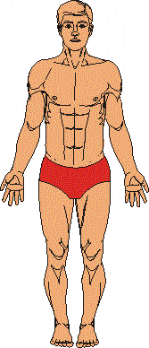
Behavior
The purpose of this section is to introduce the concept that people’s movement is predictable or at least not what we may think it is
Topics:
Why people walk in circles
Lost person behavior
(click to advance)

Slide 5
Why People Walk in Circles
The human body is symmetrical. Actually, it is slightly asymmetrical or lopsided.
98% of the population are born right-handed.
Their right arm tends to be longer, stronger, and weighs more.
Their right shoulder hangs ½” to 1” lower.
The left brain is slightly larger as is the cranial cavity.
However, there is no relationship between being right or left handed and whether people veer right or left. (continued on next slide)
(click to advance)

Slide 6
Why People Walk in Circles
Right-handed swimmers tend to veer to the left.
It is because the stronger right arm over powers the left arm.
The legs exhibit similar differences and the difference determines which way a person will walk.
The problem is that few people’s legs have been measured.
55% of people veer right; 45% veer left.
As noted, it is not related to being right-handed.
Conclusion: People veer. It is due to differences in leg size. Unless you have measured the size and strength of the legs, it is difficult to determine which way people veer, but they will veer.
(click to advance)

Slide 7
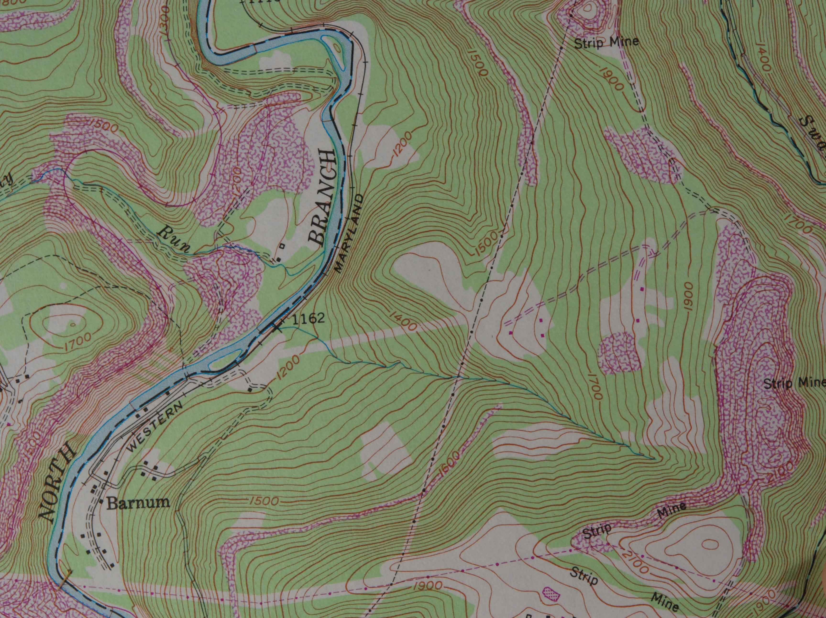
Example of Determining the Search Area:
We can learn a lot about people’s behavior from lost person behavior.
Do lost people tend to walk uphill, same level or downhill?
___ uphill
___ stay at same level
___ downhill (click for answers/trivia)
Trivia:
Only 7% of hikers and hunters move uphill
50% of hikers descend
33% of small children move uphill (click for barrier)
Does the river act as a barrier (i.e. Would you cross it?)
___ yes
___ no
Where would you go to be found? To not be found? (click)
Not found: Cross river, upstream, up hill
34%
21%
45%
X
(PLS) Point Last Seen
X
(click to advance)

Slide 8
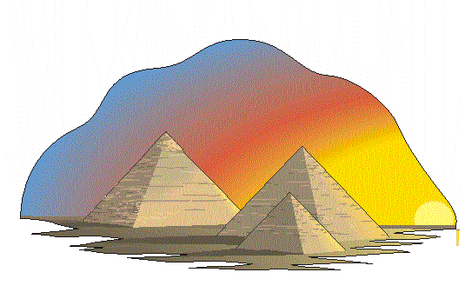
Mental Maps
Definition: Mental map are the pictures we retain in our minds.
Types (table of contents):
Home centered reference system
Self-centered reference system
Local reference system
Local reference maps
Purpose: We create mental maps all the time.
e.g. , in the kitchen….
e.g. To the grocery store. …
We are creatures of habit. e.g. Birds in the backyard.
Mental Maps
(click to advance)

Slide 9
Mental Maps – Some Trivia
Definition: Mental map are the pictures we retain in our minds.
Walking – 3 mph with a 30” pace on level ground
Canoeing – 2.5 mph on flat water.
Objects look much nearer than they actually are when:
Looking up or down hill.
There is a bright light on the object (warm colors)
Looking across water, show or flat sand.
The air is clear
Objects look much further away than they actually are when
The light is poor.
The color of the object blends with the background (cool colors)
The object is at the end of a long avenue.
Note: More on next slides
(click to advance)

Slide 10
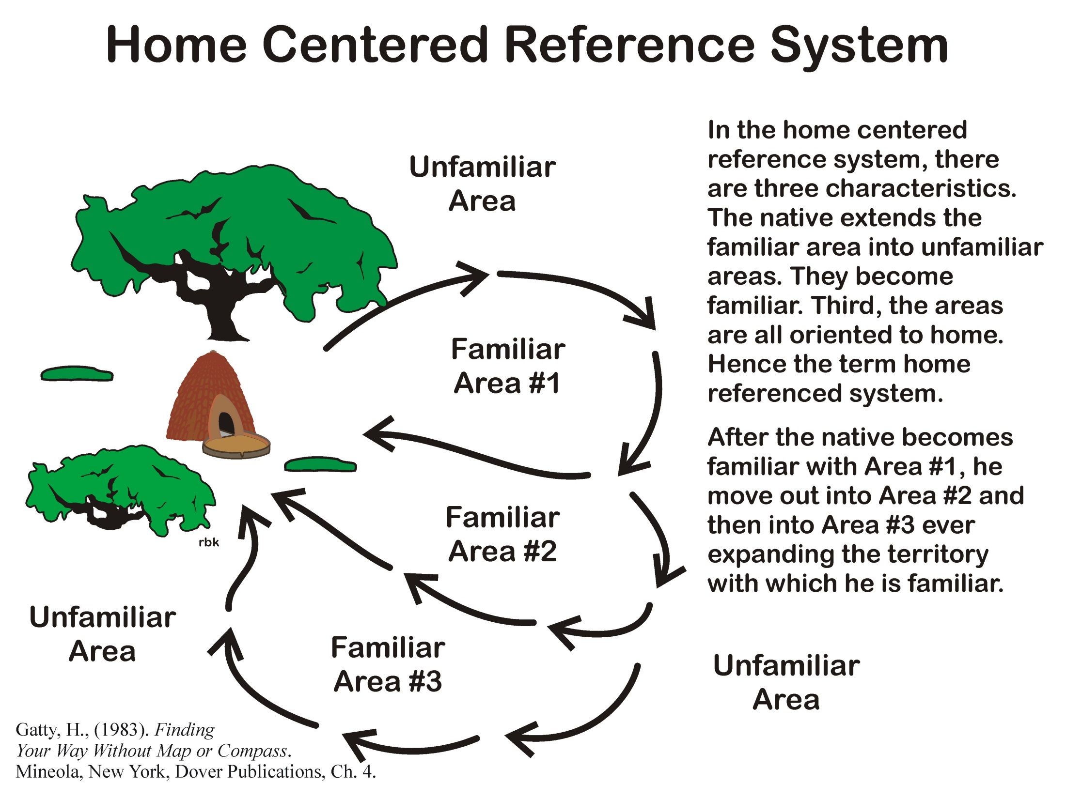
(click for Area #2)
(click for Area #3)
(click to advance)

Slide 11
(click to advance)

Slide 12
(click to advance)

Slide 13
(click to advance)

Slide 14
Question: If you were making a map of this scene, what features would you note? (click for legend)
(click to advance)

Slide 15
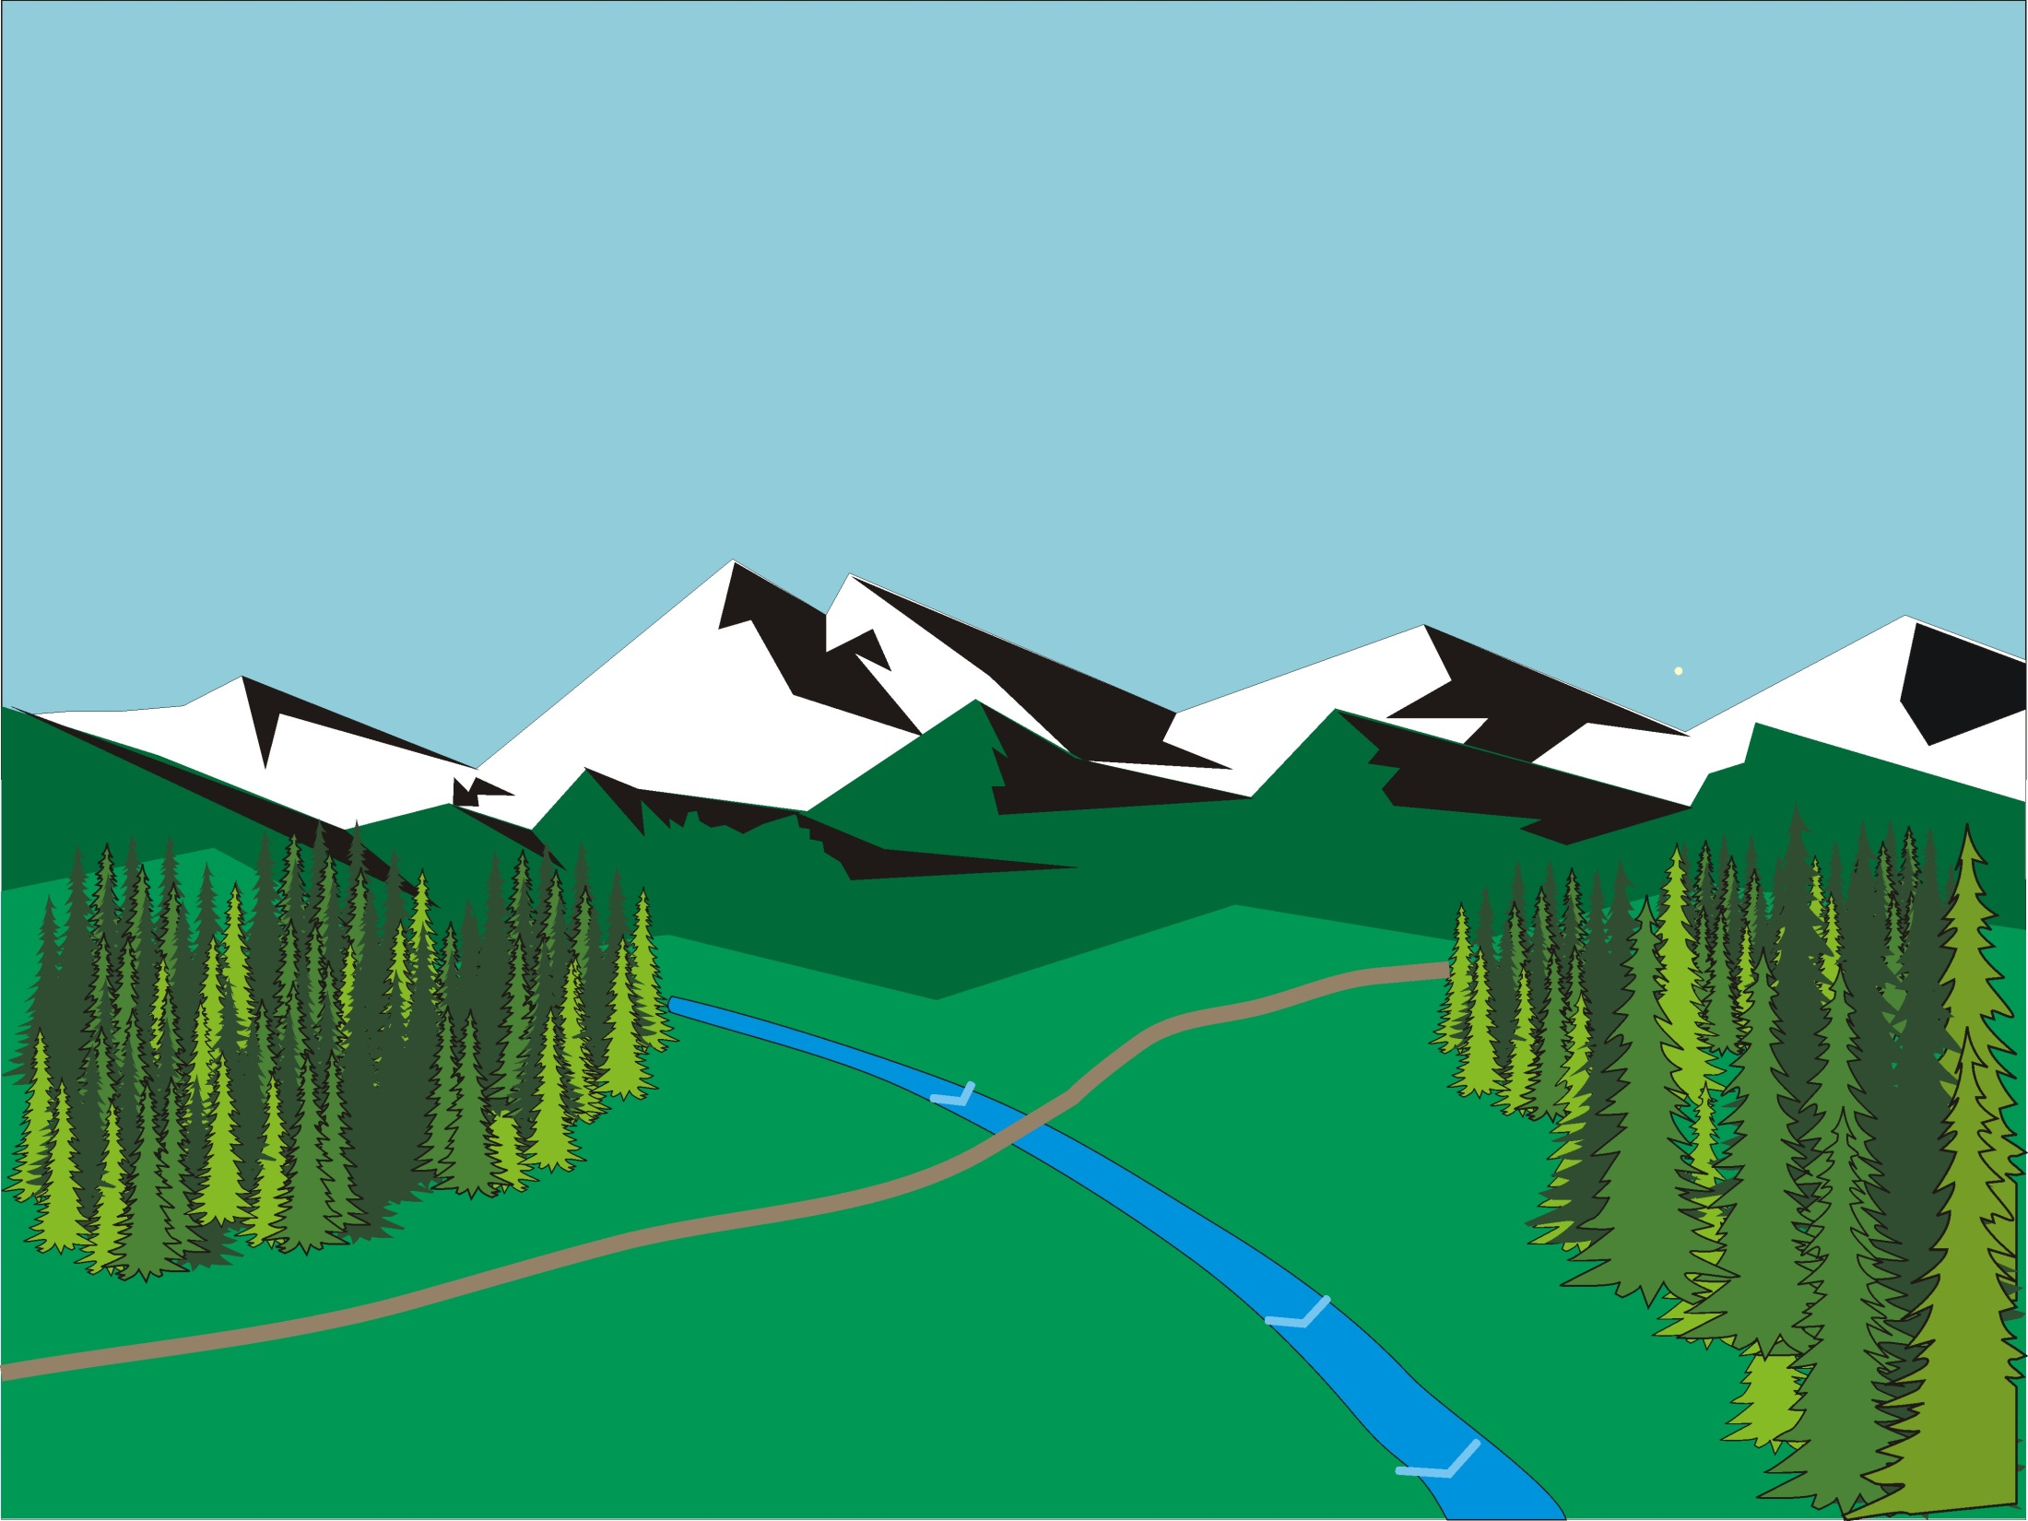
Exercise – Map making
We are going to leave the room and enter the hallway to make a map based on your memory.
(click to advance)

Slide 16
Navigational Techniques
Table of Contents:
Looking backwards
Aiming off
Estimating distance
Can moss indicate north?
Differential snow melt
Prevailing winds
Celestial navigation
Watch method – Note: time and the compass are related
The shadow knows
(click to advance)

Slide 17
(click to advance)

Slide 18
(click to advance)

Slide 19
(click to advance)

Slide 20
Estimating Distance
Walking – 3 mph with a 30” pace on level ground
Canoeing – 2.5 mph on flat water.
Objects look much nearer than they actually are when:
Looking up or down hill.
There is a bright light on the object (warm colors)
Looking across water, show or flat sand.
The air is clear
Objects look much further away than they actually are when
The light is poor.
The color of the object blends with the background (cool colors)
The object is at the end of a long avenue.
Note: More on next slides
(click to advance)

Slide 21
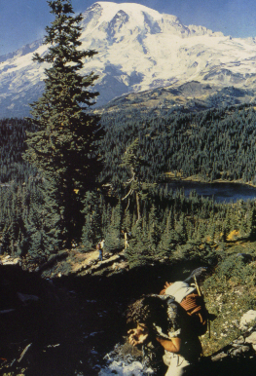
Identifying Distance:
Background
Viewing Distances
Foreground:
0 to ¼ to ½ mile
Middle Ground
Middle Ground:
¼ - ½ to 3 - 5 miles
Background:
3-5 to infinity miles
Specific characteristics of each distance are on the following slides. (Specifics on following slides)
Foreground
21
(click to advance)

Slide 22
Foreground:
Rule: Color, texture, and form change with distance
Colors appear as they actually are
0 to ¼ to ½ mile
You see the individual branches on the trees
Foreground
Texture - trees feel coarse.
22
(click to advance)

Slide 23
Middle Ground:
¼ to ½ mile to 3-5 miles
Color shifts toward darker colors
You see the outline of individual trees as part of the mass of trees
Middle Ground
Texture - trees feel coarse.
23
(click to advance)

Slide 24
Background:
Background
3-5 miles to infinity
Large areas become viewed as a single object
Snow on mountains
Forests merge as one
Color shift
Texture – objects appear as smooth.
24
(click to advance)

Slide 25
Can You Tell?
Background
Determine where the boundaries are between the foreground, middle ground and background
Middle
Ground
Where is the line between the Foreground/Middle Ground? (click for line)
Foreground
Where is the line between the Middle/Background? (click for line)
25
(click to advance)

Slide 26
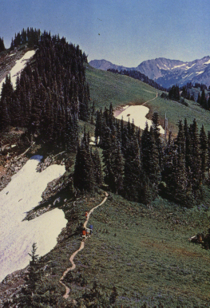
Can You Tell?
Background
Middle
Ground
Check color shifts
Check trees merging together and objects blending into a common mass
Where is the line between the middle and background? (click for line)
Foreground
Where is the line between the foreground and middle ground? (click for line)
26
(click to advance)

Slide 27
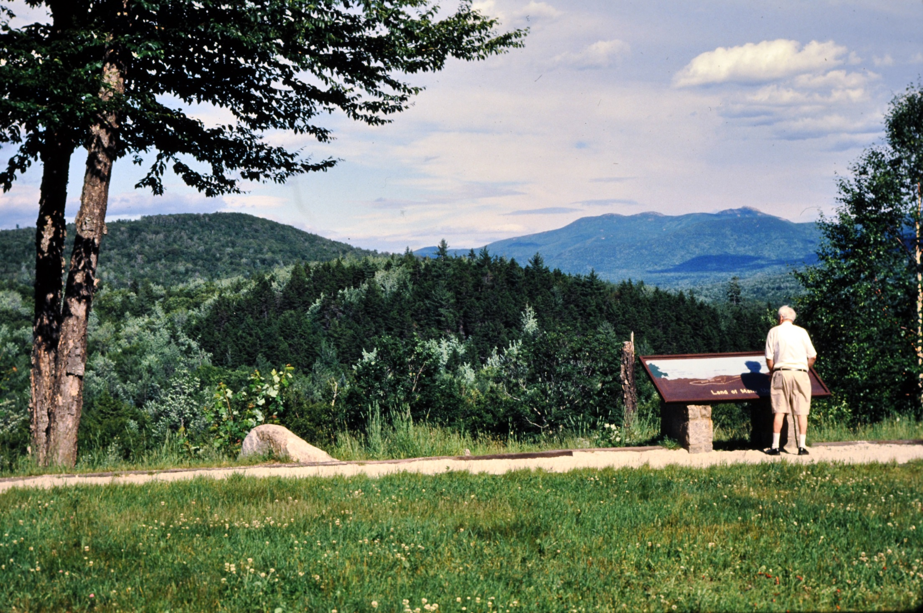
Can you tell?
Foreground
Middle-ground
Background
Foreground
Foreground
Middle-ground
Background (click for each)
Foreground
(click to advance)

Slide 28
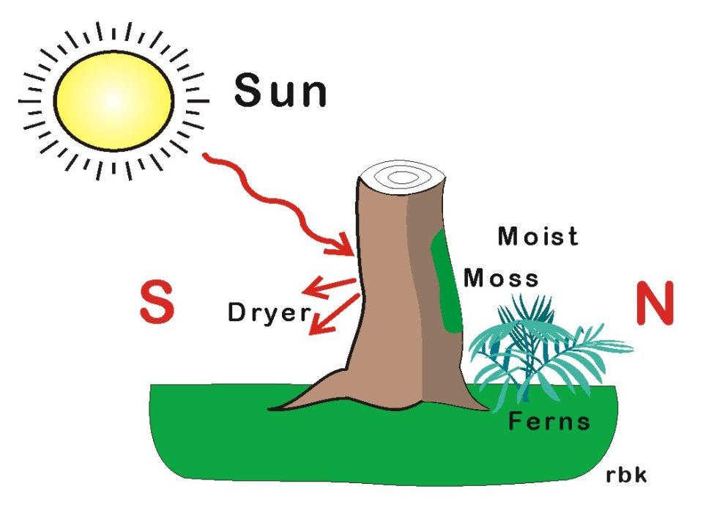
Moss Growth Indicates North
Does moss grow on the north side of the tree? Radiation from the sun heats the southern portion of the tree. It is dryer and less likely to support moss. In contrast, there is more moisture on the north side resulting in the moss tending to grow on the north side.
_____ true
_____ false (click for answer)
Rationale:
Given the right circumstances, moss growing on the north side might be true. Unfortunately, there are a lot of intervening variables which makes the statement most likely not true.
I will find situations where it works, but I would not trust navigating using it.
X
(click to advance)

Slide 29
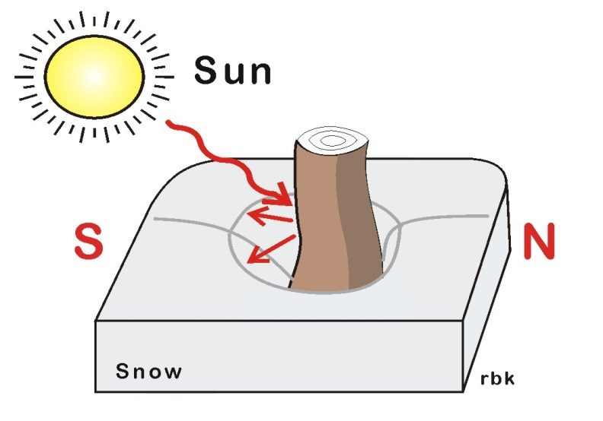
Differential Snow Melt
More snow melts on the south side of a tree. In the winter with snow on the ground, the sun will melt more of the snow on the southern portion of the tree, lamp post, etc.
_____ true
_____ false (click for answer)
Rationale:
The radiated heat from the sun creates differential heating of the tree.
The heat from the tree will melt more snow on the southern portion of the tree.
Be sure the tree is unobstructed.
X
(click to advance)

Slide 30
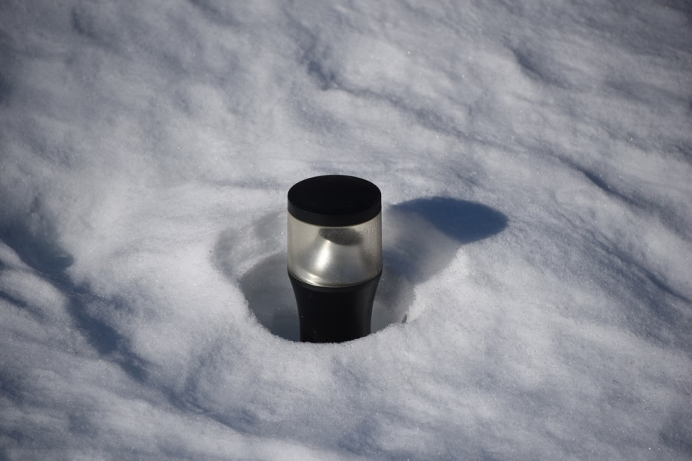
Test the Theory Out for Yourself
Test it out for yourself. This is a picture of a small bollard after two days of melting snow.
The photo was take at 2:00 pm in late January.
Is there differential melting?
Is the melting consistent with where the sun is located?
Can you tell where N is from the shadow? (Note: Revisit this use the clock face method several slides later.)
(click to advance)

Slide 31
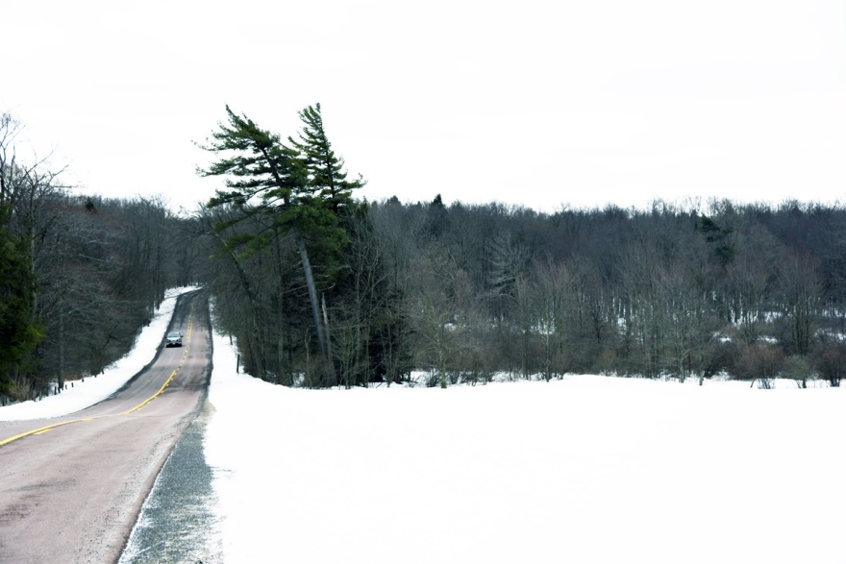
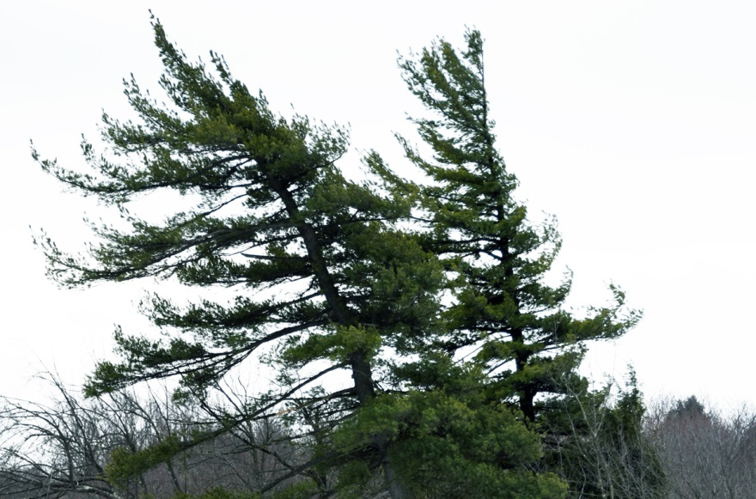
Prevailing Winds
The prevailing winds can mold, sandblast and shape trees.
Premise – the trees need be exposed, like the evergreens, particularly the portion above the other trees (see lower photo)
In North America, the prevailing winds are from the west.
Look for:
… Branches on the west that are shorter than those on the east.
… The trunk being bent by the prevailing winds.
… The branches on the tree on the right literally being sandblasted by the wind and snow. (click for compass)
S
E
W
N
(click to advance)

Slide 32
(click to advance)

Slide 33
(click to advance)

Slide 34
(click to advance)

Slide 35
(click to advance)

Slide 36
(click to advance)

Slide 37
The Shadow Knows – Determining North
Returning to the bollard, the clock face rule can be applied to the shadow. The photo was take at 2:00 p.m. in late January. (click to advance)
The Bollard casts a shadow; it is 2:00 p.m. (click to advance)
Draw a line through the shadow and continue it toward the sun. This is the hour hand. (click to advance)
Determine 12:00Superimpose the 12:00 o’clock line. (click to advance)
Bisect the angle made by the 2:00 and 12:00 lines. This is the N/S line (click to advance)
Determine North
(click to advance)

Slide 38
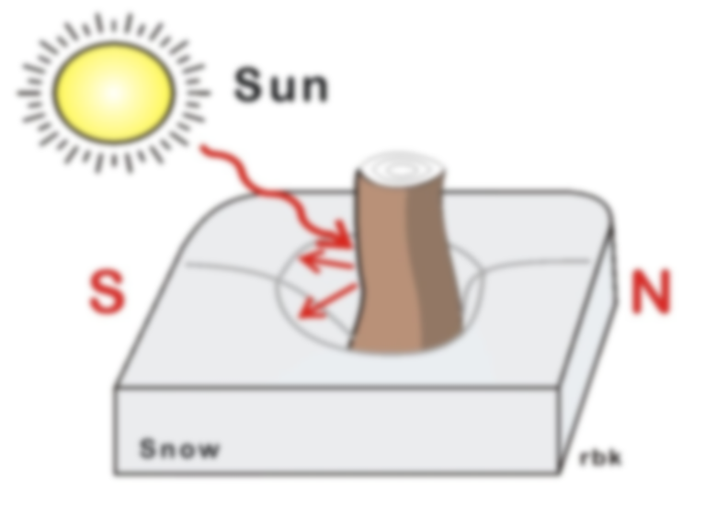
Using the Shadow Works Too:
The 2:00 p.m. and 12:00 o’clock lines create intersecting lines. The angle is the same on both sides. (click for clock face)
If you use the angle made by the shadow, the bisected angle is actually pointing north. It is a reversal.
Either way it works.
The corollary is that if you know the time of day and possess a shadow (e.g. sundial), you can determine north and direction.
Even if you can only approximate the time, it works.
(click to advance)

Slide 39
References
Carss, B., (2009). The SAS Guide to Tracking. Guilford, Connecticut: Lyons Press.
Fear, G., and Mitchell, J., (1977). Fundamentals of Outdoor Enjoyment. Tacoma Washington: Survival Education Association.
Gatty, H., (1983). Finding Your Way Without Map or Compass. Mineola, New York, Dover Publications, Ch. 4.
Koester, R., (2008). Lost Person Behavior – A search and rescue guide on where to look – for land, air and water. Charlottesville, Virginia: dbS Productions.
(click to advance)

Slide 40
The End
(advances automatically)

Slide 41
The End
(click to advance)

Slide 42
The End
(advances automatically)

