Slide 1
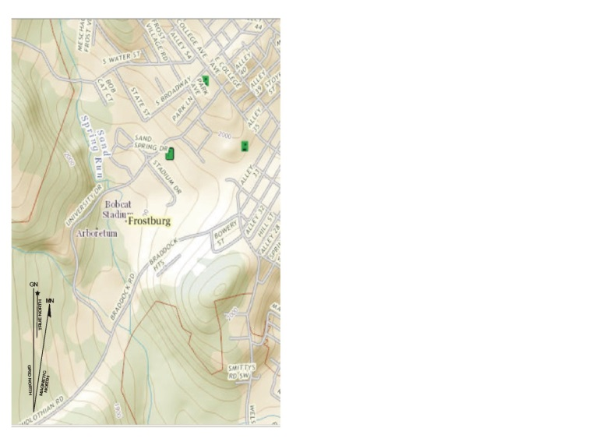
Navigation - Maps
Maps
Focus
(click to advance)

Slide 2
This section focuses on using topographic maps.
(click to advance)

Slide 3
Topographic Maps
Typology:
Exercise – Draw a map of the room
Colors (next slide)
Lines of longitude and latitude (covered here)
Contour lines
Stream flows
North
Scale
Map features and symbols
Orienting the map
(click to advance)

Slide 4
Exercise
Phase #1: Draw a map of the room. Tasks are listed below.
Diagram the room and its contents
Indicate the doors and other key items
Provide a key
Provide a scale (click for Phase #2)
Phase #2: Exchange your map with the person next to you..
Orient the map … align the door, etc. with where it should really be.
Items you think are missing
Does it accurately reflect the room?
(click to advance)

Slide 5
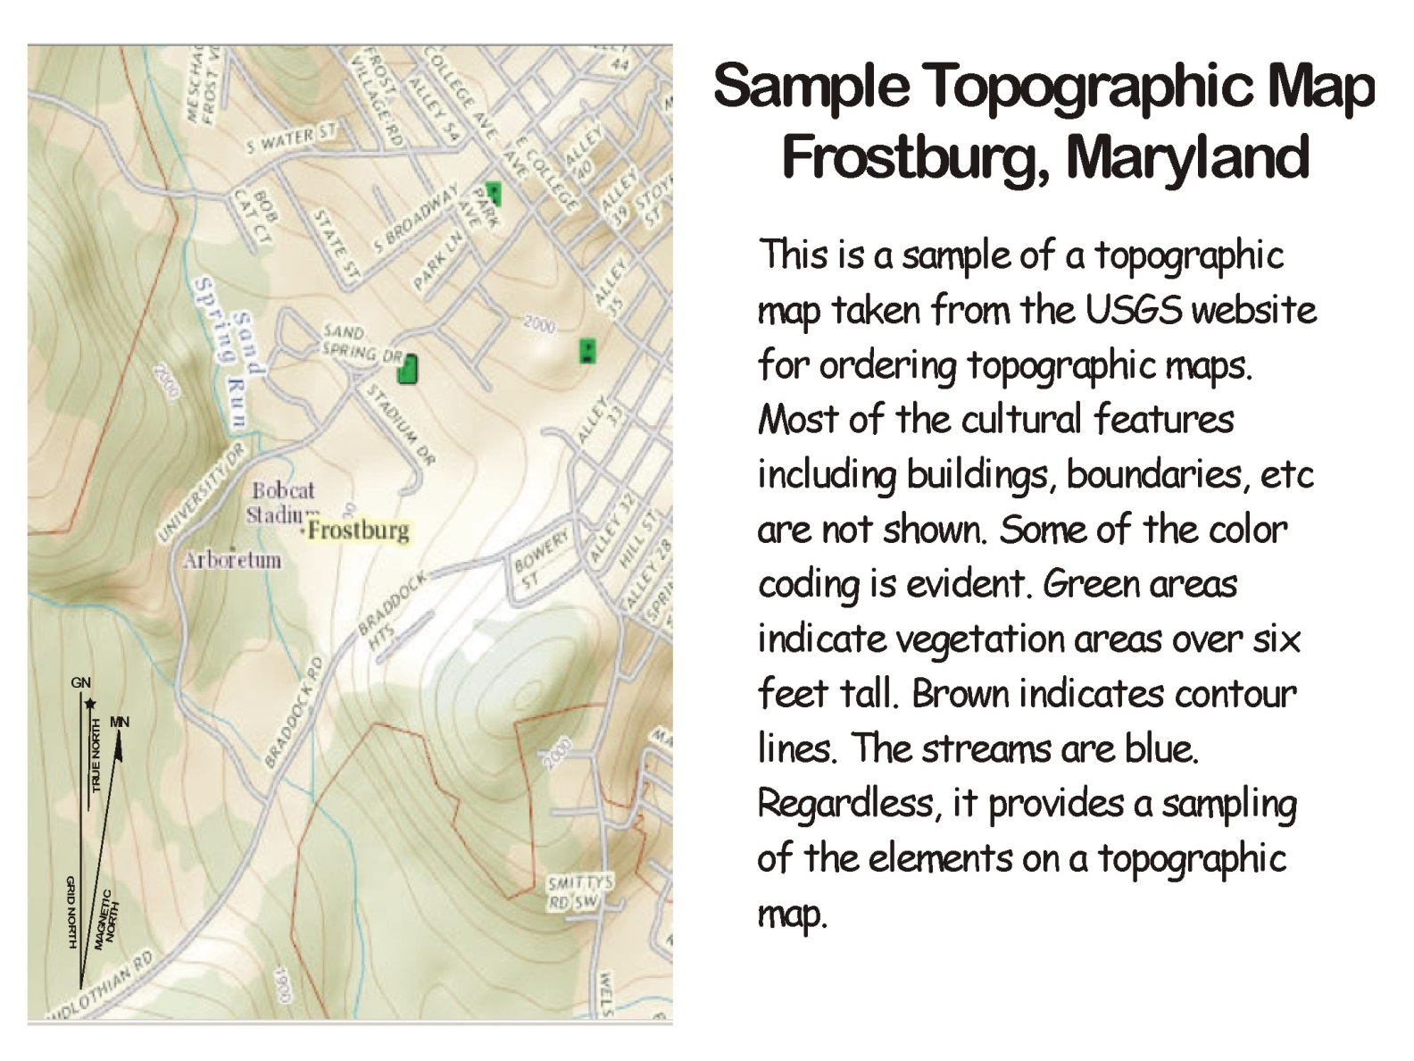
(click to advance)

Slide 6
Colors
Typology of Colors:
Black ➔ Cultural features
Green ➔ Vegetation above six feet in heights…. Army Corps of Engineers
Blue ➔ Water
Brown ➔ Contour lines
Purple ➔ Photo revisions
(click to advance)

Slide 7
(click to advance)

Slide 8
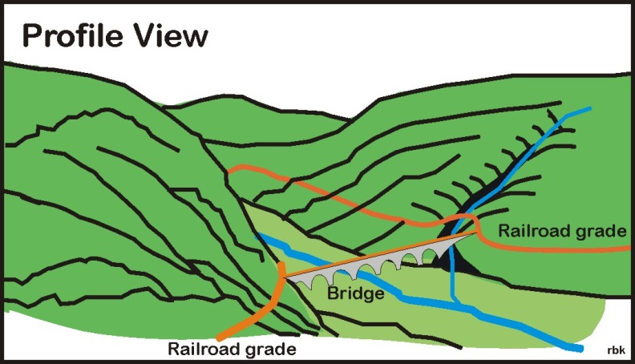
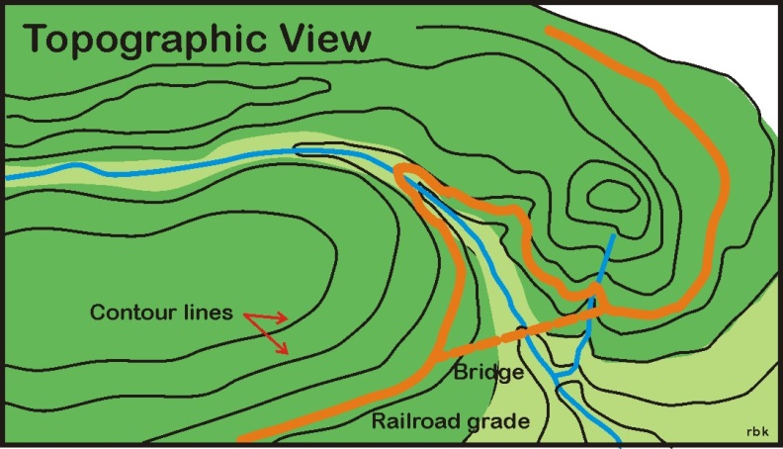
Contour Lines
Top view is a profile view
Bottom view shows the contour lines for the profile view.
Contouring – a term originally used in railroading where the railroad grade followed the contour lines.
The viaduct or bridge provides a shortcut to contouring
(click to advance)

Slide 9
(click to advance)

Slide 10
(click to advance)

Slide 11
(click to advance)

Slide 12
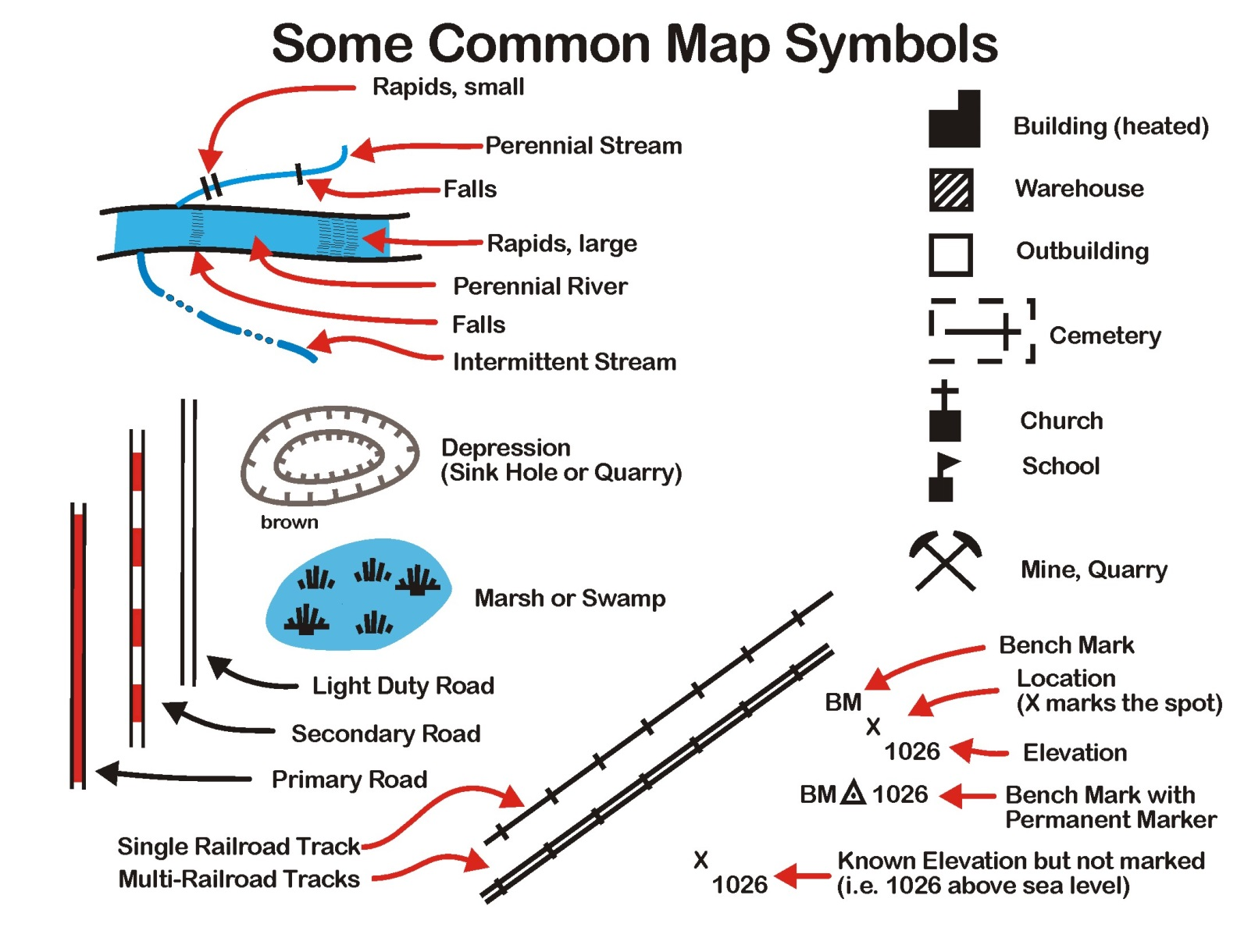
(click to advance)

Slide 13
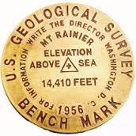
Bench Marks
USGS
Location
Feet above sea level
Date of installation
Bench Mark
(click to advance)

Slide 14
(click to advance)

Slide 15
The End
(advances automatically)

Slide 16
The End
(advances automatically)

