Slide 1
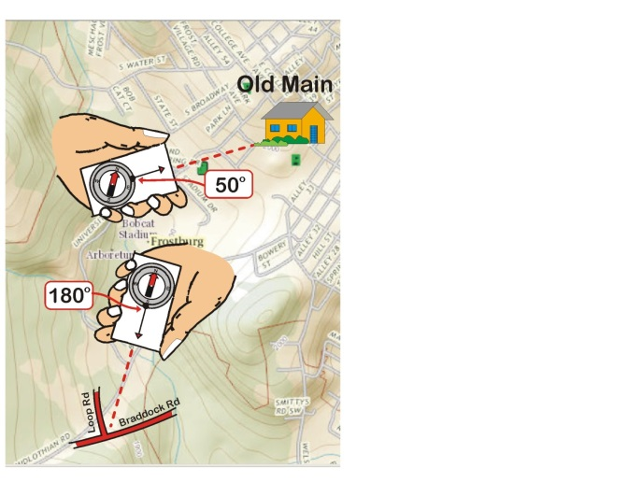
Navigation – Map and Compass
Map and Compass
Focus
(click to advance)

Slide 2
This section focuses on using maps and compass together.
(click to advance)

Slide 3
Map and Compass
Typology:
Map and Compass
Triangulation
The diagram on left shows triangulation which occurs second in this section.
(click to advance)

Slide 4
(click to advance)

Slide 5
(click to advance)

Slide 6
(click to advance)

Slide 7
(click to advance)

Slide 8
(click to advance)

Slide 9
(click to advance)

Slide 10
(click to advance)

Slide 11
(click to advance)

Slide 12
The End
(advances automatically)

Slide 13
The End
(advances automatically)

