Slide 1
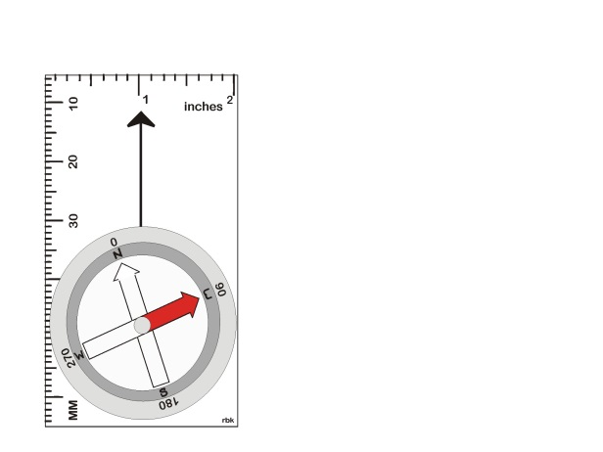
Navigation - Compass
Compass
Focus
(click to advance)

Slide 2
This section focuses on using a compass.
(click to advance)

Slide 3
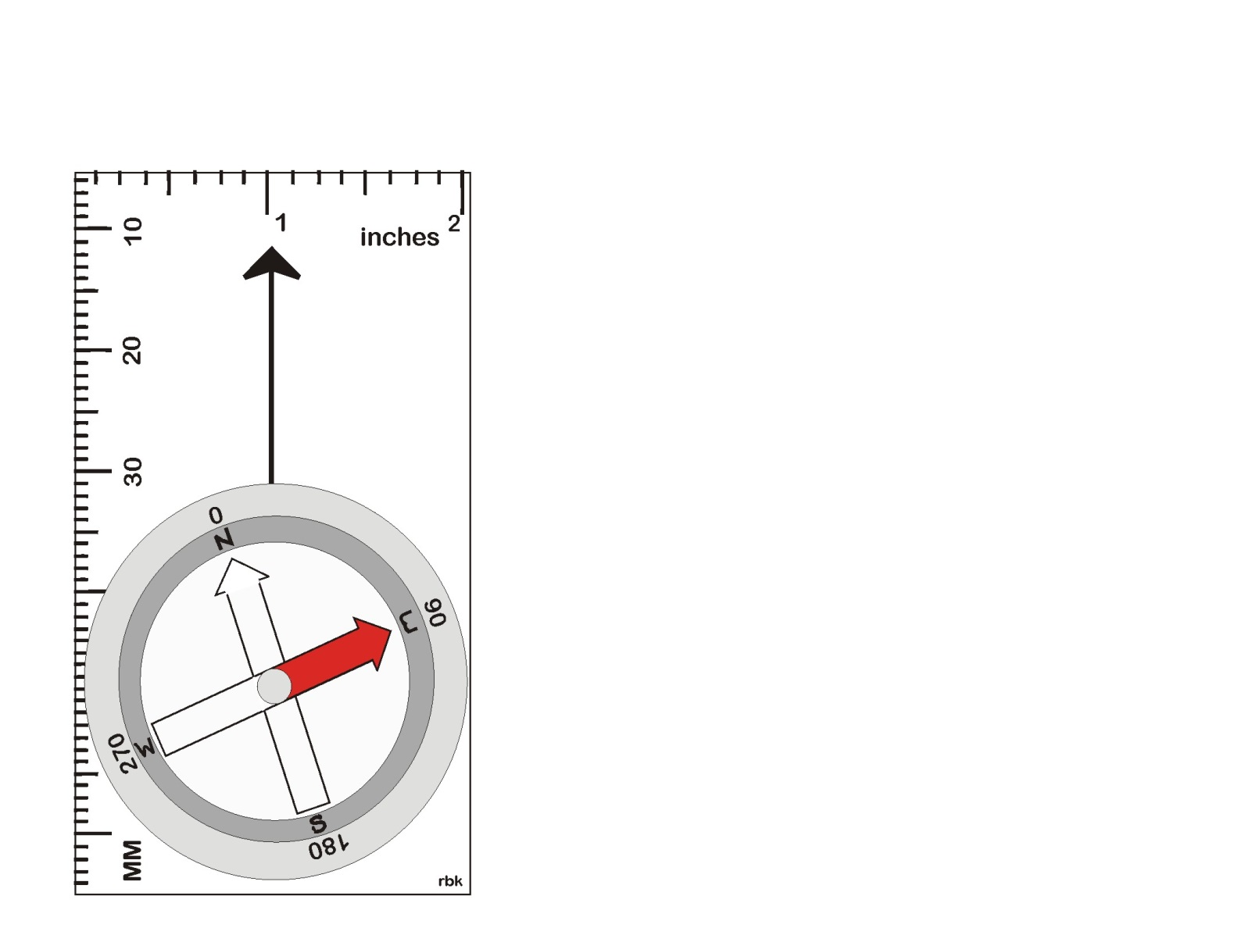
Compass
Typology:
Compass
Parts of a Compass
Declination
Method #1: Find a bearing to an object
Method #2: Given a bearing, find an object and travel on that bearing.
(click to advance)

Slide 4
(click to advance)

Slide 5
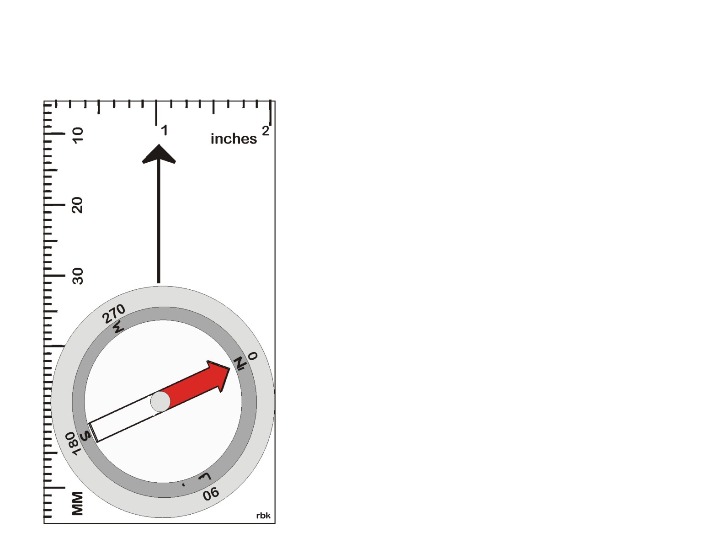
Magnetic North
It is the place where the compass needle points (click for north)
It is not the north pole. It is a place in Hudson Bay, Canada.
It is a commonly agreed upon point of reference
It moves and changes location
Declination – Defined as the difference between the magnetic lines of flux and the lines of longitude. (next slide) (click for North)
The compass needle’s north and compass housing north are aligned and pointing to North.
Rotate the compass housing
Magnetic North is here
Rule: North is to North. North always points north.
(click to advance)

Slide 6
Magnetic North and other Norths
(click to advance)

Slide 7
(click to advance)

Slide 8
(click to advance)

Slide 9
The End
(advances automatically)

Slide 10
The End
(advances automatically)

